Slide 1
Transition from Elementary to Upper School

Slide 2
Agenda
Goals and Objectives
Curriculum
Getting your child organized
Online resources
Social Media

Slide 3
“The transition is often complex. As young adolescents are changing school buildings they are also changing hormonally, mentally, and physically. This transition affects young adolescents' academic experiences, motivation, self-perception, and self-regulatory beliefs”
(Parker, 2013; Perkins, 1995).

Slide 4
Positive Aspects of Transition
Choosing classes
Making new friends
Participating in sports and clubs
More personal and social freedom
Changing classes
Electives
Opportunity for advanced courses
Ability to self monitor through Pinnacle

Slide 5
Montessori in Middle School
Inquiry based Learning with real world applications
Concrete representations move to the abstract
Individualized learning
Dynamic classroom
Teach the whole child: physical, social, emotional, cognitive
Responsibilities are passed to the child
Balance of power

Slide 6
The Montessori Philosophy
Developmentally appropriate, based on the needs of the adolescent
Sharing ideas and collaborative work
Respect and embrace differences
Pursue individual or group interests in greater depth
Reflects on moral and global issues
Participating and giving back to the community
Intrinsic Motivation

Slide 7
The Goals
Cosmic education- we are all part of something bigger
Peace building, tolerance and conflict management
Respect for self, others and the environment
Philanthropic goals
Critical thinkers
Practical skills
Global awareness
Goal: An independent, productive member of society

Slide 8
Curriculum
Class schedules- A 5 Period Day
Language Arts
Math
Science
Social Science
Elective

Slide 9
Middle School Mathematics Options
Regular Mathematics
Advanced Mathematics
GEM Mathematics
EMF Mathematics

Slide 10
Regular Mathematics
Designed for students with average ability in mathematics
Continue the development of mathematical concepts and processes that can be used to solve real-world and mathematical problems in preparation for high school Algebra and Geometry

Slide 11
Advanced Mathematics
Very challenging and designed for students who are mathematically talented.
By the end of middle school, students will be accelerated by one grade level.
The middle school student will have the opportunity to complete high school Algebra I Honors in 8th grade.
The student successfully completing the Algebra I Honors course will earn one high school mathematics credit when they enter 9th grade.

Slide 12
GEM Mathematics
Extremely rigorous
Accelerated by two grade levels.
6th Grade – Pre-Algebra
7th Grade – Algebra I Honors
8th Grade – Geometry Honors
Designed for mature, mathematically talented students.
Assignments are regularly given which may require many hours beyond the school day to complete.
Students are continuously monitored and must maintain GEM criteria.
The student successfully completing the Algebra I Honors course and Geometry Honors course will have two high school mathematics credits when they enter 9th grade.

Slide 13
GEM-6 ENTRANCE CRITERIA
350 or higher on the 5th grade math FSA and
336 or higher on the 5th grade reading FSA
The GEM entrance is used to provide additional information to parents
Students must be self motivated

Slide 14
EMF Mathematics
Extremely rigorous
Students will finish coursework through Pre-Calculus while in Middle School- Calculus AB in 9th grade
Designed for uniquely-qualified and mathematically talented students.
Online curriculum developed by IMACS
Students are continuously monitored and must maintain the EMF pace and grade requirements.
The student successfully completing the 3 EMF courses and EOC requirements will be enrolled in AP Calculus in high school after
passing the pre-test.
Qualified students will be notified by the district and will start in June

Slide 15
Upper School Science Options
G.E.A.R.S
Advanced Science
Regular Science

Slide 16
G.E.A.R.S
Genuine Explorations, Applications and Research in Science
This is a 6th grade comprehensive accelerated science class. It uses inquiry based learning, where the students must produce and site their evidence by investigating real world science, while simultaneously integrating the 7th and 8th grade standards within the 6th grade curriculum.5th Grade ELA FSA – Level 4 or 5
5th Grade Science Grades C, Teacher Recommendation
Grade 6: Comprehensive Science Accelerated 1
Grade 7: Comprehensive Science Accelerated 2
Grade 8: HS Honors Biology

Slide 17
Curriculum
Electives/Specials

Slide 19
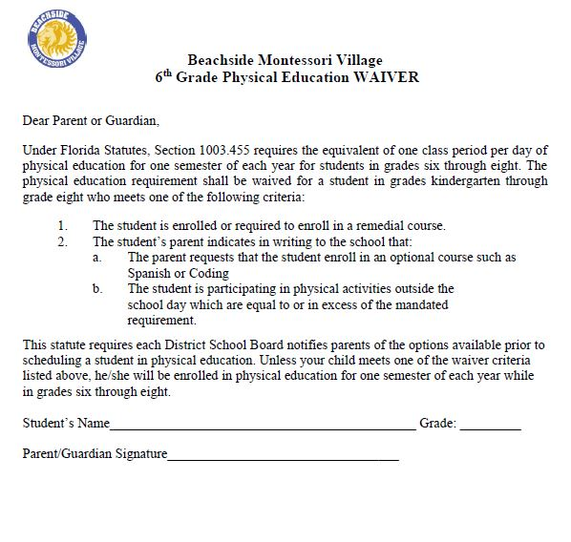

Slide 20
NEW ELECTIVE 2018-2019!
SCIENCE OLYMPIAD
Science Olympiad is a nationally recognized science competition for middle and high school students.
All events are team based, interactive, and include strong authentic assessment.
Students have fun and are motivated to learn science!
Students engage in pre-build engineering events, laboratory experiments, and research activities that provide a strong foundation for a future career in science, technology, engineering, and mathematics.
Each team competes in 23 different events that are as diverse as Rotor Egg Drop, Forensics, Forestry, Maglev, and Experimental Design.
This class is capped at 16 students and is currently FULL

Slide 21
Resources
Pinnacle
BEEP
Student Advantage
Online Study Help

Slide 23
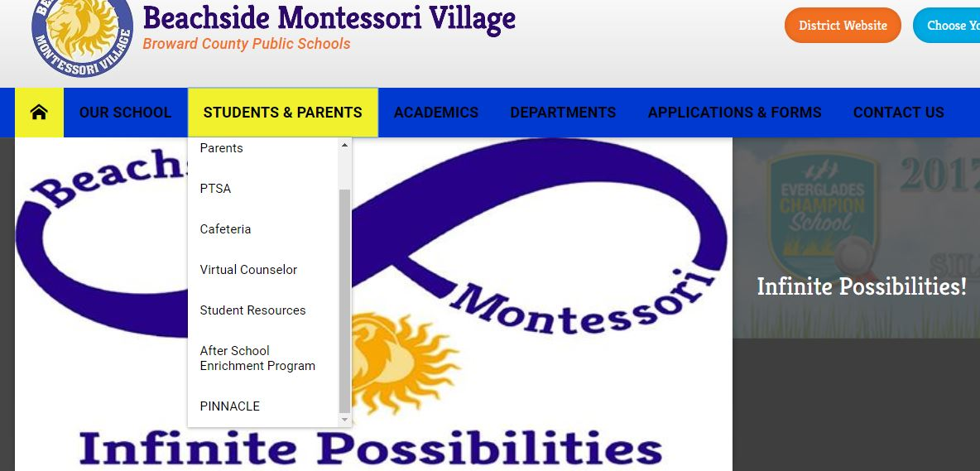
https://www.browardschools1.com/beachside

Slide 24
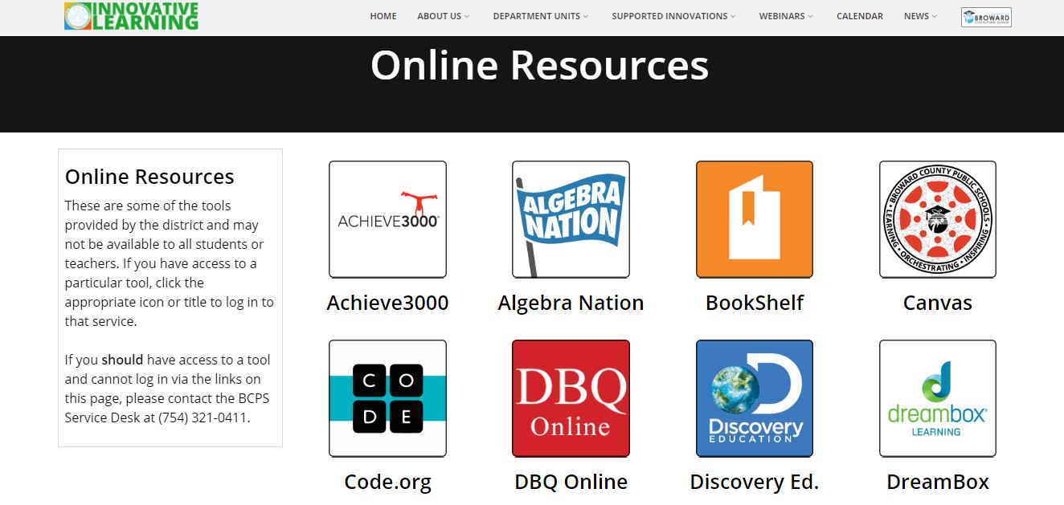
beep.browardschools.com
One Stop Shop for Online School Resources

Slide 25
Microsoft Office Student Advantage
http://www.browardschools.com/studentadvantage

Slide 26
Social media is changing the way we communicate and the way we are perceived, both positively and negatively. Every time you post a photo, or update your status, you are contributing to your own digital footprint and personal brand.

Slide 27
Social Media and Adolescents
Think before you post
Privacy Settings
No Personal information
Maintain open communication with your child
Know passwords
Monitor as needed
Don’t over-react if problems occur
College “adcoms” will look at social media

Slide 28
What Parents Can Do
If you have raised adolescents, be willing to share advice and information with other parents
Be open-minded to different teaching methods i.e. project based learning
Encourage a structured study hour
Encourage good organization skills
Monitor Pinnacle
Be sure to review and know the dates of Interims and Report Cards
Realize the importance of a productive struggle
Maintain a good working relationship with your child’s teachers
Know and understand school rules i.e. dress code, late work policy
Attend meetings (PTA, conferences, etc.) and child’s activities
Make sure your child attends school daily
Volunteer in any way you can

Slide 29
